Slide 1
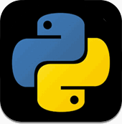
A look at Python
Programming
Language
2018

Slide 2
Resources
Vocabulary:
Input
Output
Comments
Statements
Operators
Variables
Syntax (and Syntax Error)
Strings
Algorithm
Loop (for)
Conditions (If else)
function
Python.org (installation)
https://www.pygame.org/news (pygames coder to make games)
https://securitybaron.com/blog/cryptography-and-coding-informationhttps://www.pygame.org/news/ (encryption and relating to security and code)
www.codeacademy.com/afterschool (costs money)
http://www.nostarch.com/teachkids (samples)
https://www.quickstart.com/blog/10-famous-websites-built-with-python/ (Famous sites using Python)

Slide 3
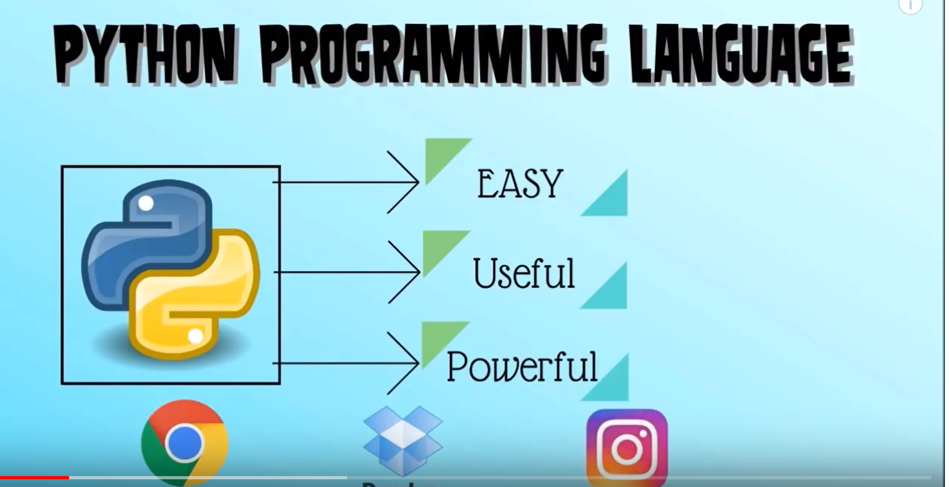
What is Python?
Gets it’s name from Monty python
Open Source
high-level programming language
Invented by Guido van Rossum (Dutch programmer)
Very flexible

Slide 4
The Environment (Use IDLE)
Do some commands right in the “Python Shell”
2. To edit and run programs, go to FILE|NEW FILE. They must be saved before they will run.
To Open Python IDLE,

Slide 5
Print(“Hello World!”)
Write your first Program
Put the line above directly in the Python shell*
Hit “Enter”
Check the resulting “OUTPUT”
#A line of code is sometimes called a “STATEMENT”. Programs can be made from 1 or more STATEMENTS.
*Allows user to enter commands or lines of code directly.

Slide 6
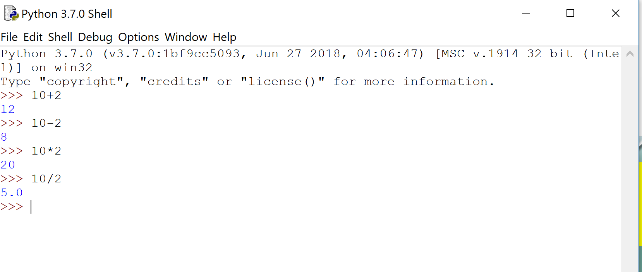
You can also do math problems…
Use +, -, *, / (math operators) with numbers directly in the Python shell*
Hit “Enter”
Check the resulting “OUTPUT”
*Allows user to enter commands or lines of code directly.

Slide 7
To edit, save, and run longer programs:
Go in Python Shell to FILE|new window
Try this program that asks for your name.
Click RUN>Run Module
Save it as “your name”.
The red item #with instructions or explanations is called a COMMENT. These are not part of the program itself, they are just helpful descriptions.
Line 2 asks the user to input their name, which it remembers as the variable “name”.
In Line 3, the program prints out the “Hi, with the variable name.

Slide 8
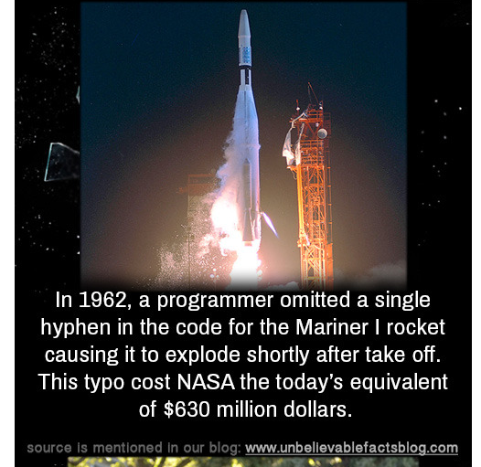
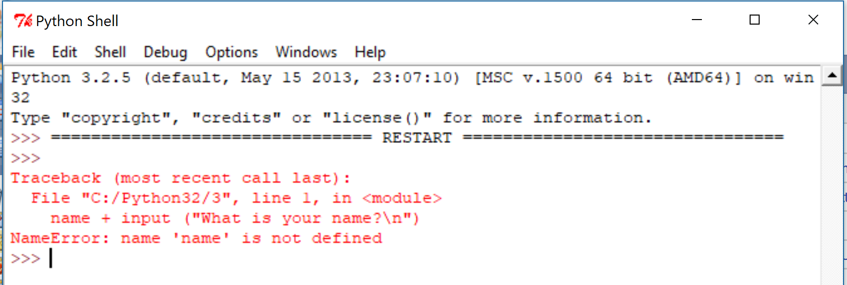
Redo the “name” program, and change the = after name to a +. (Make a mistake)
If you RUN the program, you will see something like this:
It is telling you that you have made an error. You have not defined your variable, name.

Slide 9
Syntax error
A syntax error is an error in the source code of a program.
all computer programs must follow strict syntax (Kind of like “Grammar” in paragraph writing) in order to work correctly
any aspects of the code that do not conform to the syntax of the programming language will produce a syntax error.
If you read the syntax error information, it will give you clues to your error.

Slide 10
You can even carry on a conversation, using the same syntax as the “Name” program.…
my_name = "Mrs. Vest“ my_age = "None of your business...Ha, actually, its 60“ your_name = input("What is your name?") your_age = input("What is your age?") fav_color = input("What is your favorite color?") print("Now, let's get aquainted! My name is", my_name, ", and my age is", my_age, "years old.") print("Your name is", your_name, ", and you are", your_age, ".") print("Your favorite color is", fav_color, "Hey, that's my favorite color too!")
VARIABLE: Notice that it can be determined after the = OR it can be inputted.
*The characters in the quotes are sometimes called a STRING.

Slide 11
Variables
Store different kinds of information, such as text or a number. A variable can contain different values at different points of time. (Microsoft)
Rules:
start with a letter: number_1
You can use letters, numbers, and underscores- NOT spaces
Name so they describe whatever value you are needing
Don’t use If, for, or Then (Those are used for conditional statements)

Slide 12
Now, Let’s use some numbers in a real life scenario. You work for “Hotbox” pizza. You have to take a pizza order, add 7% tax to the cost, and tell the customer what they owe totally. (These are commands a cash register is programmed to do)
You’ll have to program these items:
1. You have to ask how many pizzas the customer wants
2. You have to ask the menu cost of each pizza.
3. you have to calculate the total cost of the pizzas as a subtotal
4. you have to calculate the sales tax owed, at 7% of the subtotal
5. you have to add the sales tax to the subtotal for the final total.
6. You have to show the customer the total amount due, including tax.
So let’s try it!....

Slide 13
Welcome to “Hotbox!” Can I help you?

Slide 14
Checking understanding!
Now try to make a program for a different store, based on the Hotbox pizza program. In it:
1. in comments, name the store you work for
2. You have to ask how many items the customer wants (name your variable so we know what it is)
3. You have to record the cost of each item.
4. you have to calculate the total cost of the items bought as a subtotal
5. you have to calculate the sales tax owed, at 8% of the subtotal (0.08)
6. you have to add the sales tax to the subtotal for the final total.
7. You have to show the customer the total amount due, including tax

Slide 15
Store Rubric
Item | Credit depends on | Points possible | Your points
Use of comments, Naming and Saving | Title is present and spelled correctly as a Comment. #Comments as you go, as explanation of each part. Save as a py | 2
Variables: Items and Costs | Number and cost of items, variables written correctly (use eval) | 4
Subtotal calculation | Calculation syntax correct | 4
Sales tax figured correctly at 8% or 0.08 of the subtotal cost | Sales tax variable set up and calculated | 2
Print command used correctly to show final total from the subtotal and tax. | Strings and calculations done correctly, so that the customer gets a “receipt” | 3 Total: ____/15 | Note: This program can be done in 9 lines of code. (not including comments)

Slide 16
Other Vocabulary

Slide 17
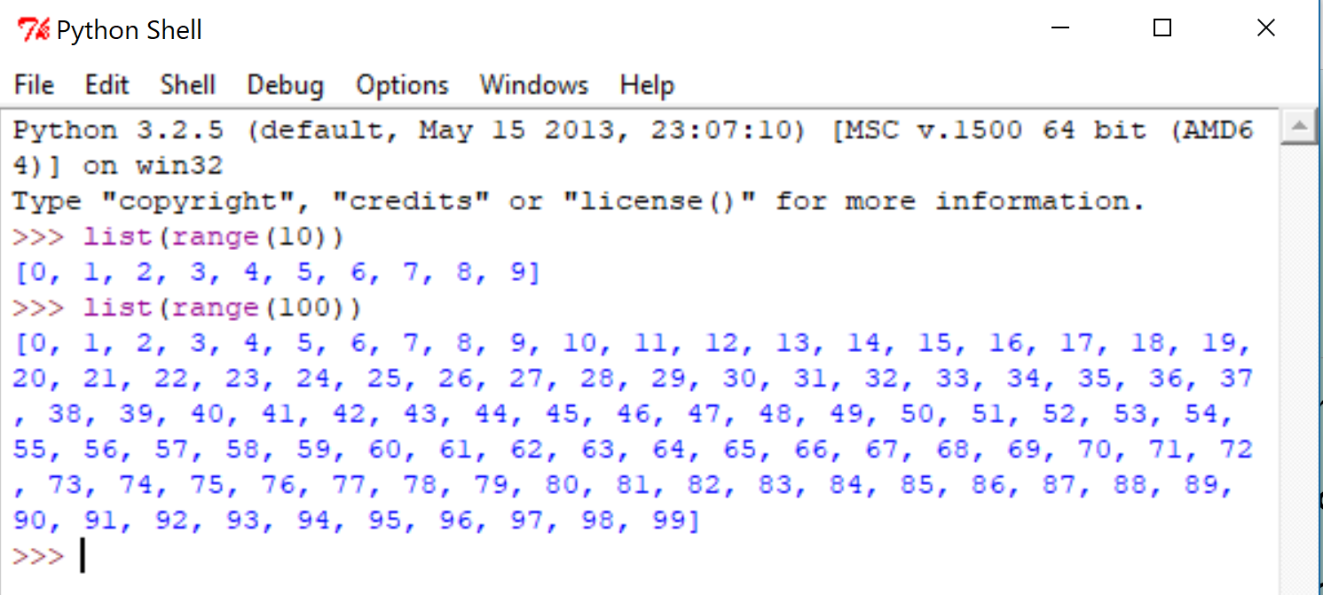
Loops
Loops are good to use if you want to repeat an action over and over
A for LOOP iterates (or repeats once for each item in a list)
You can use range() to create lists (like of numbers 0-9 or 1-100)
To see the lists printed out, use the list() function
Let’s try it right in Python Shell….
There are several types of loops. The “for loop” is a simple one that iterates a range.
A “while loop” is more complicated. This one can check for a condition (like, does a gamer want to replay a game after losing or just quit) and decide whether to loop or stop (break)

Slide 18
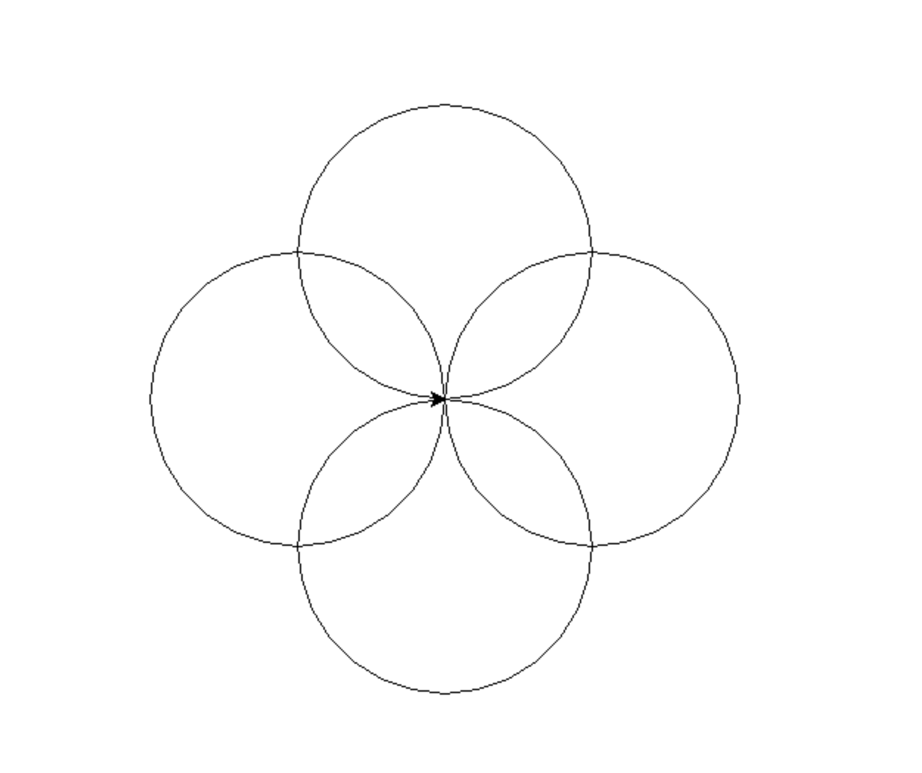
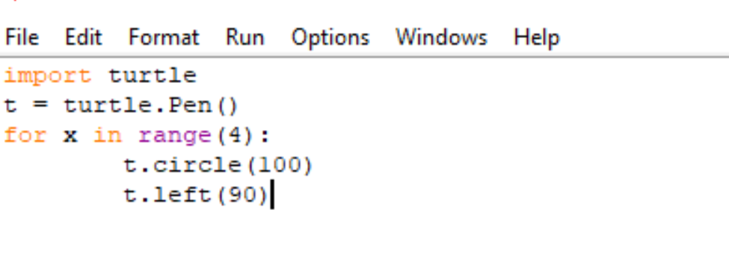
For Loops program example: Rosette
To draw a rosette, we have imported a drawing tool called “Turtle”. It is a program python (and many other languages) recognizes.
The for X in (the loop) will repeat 4 times (because it says range(4)
The last two lines instructs the turtle pen to make a circle, and then go 90 degrees left. The end result is shown.

Slide 19
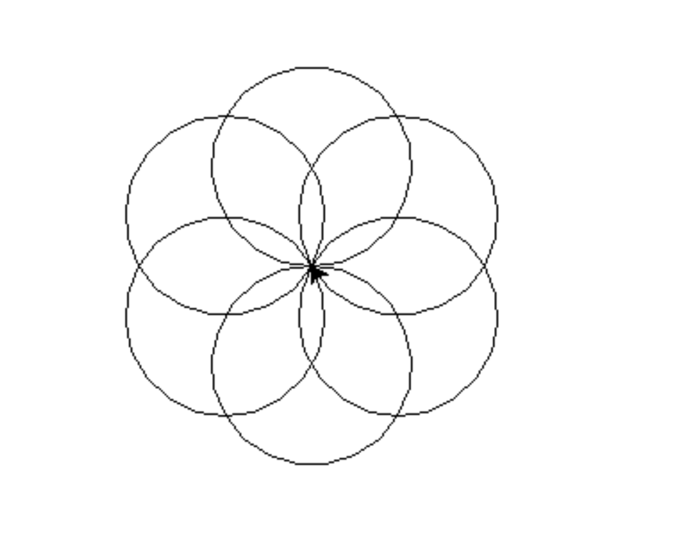
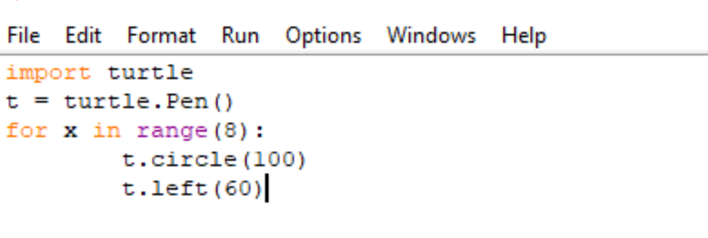
Loops program example: Rosette 2
We can adapt this program to make more circles by changing the range and the angle degree (left). Change the numbers, and see what happens to the circles/rosette.

Slide 20
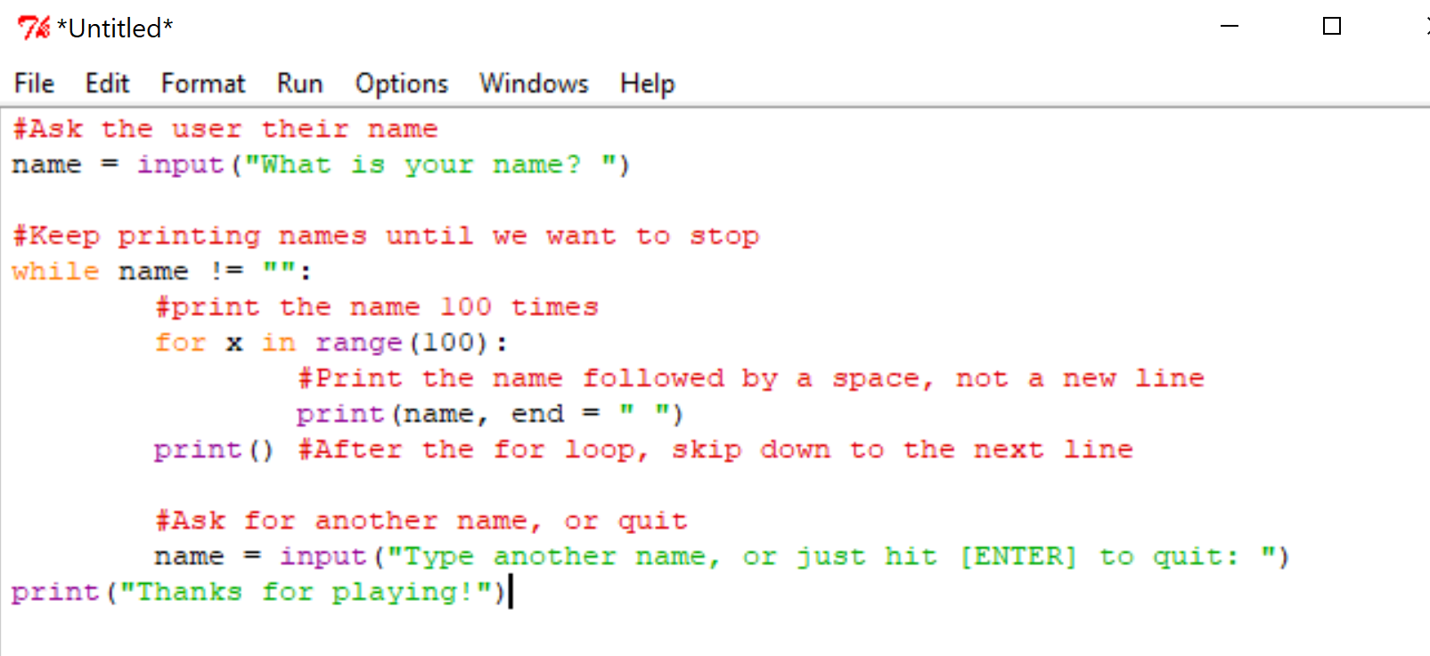
While loop example
Try this loop that will repeat your name until you tell it to stop:

Slide 21
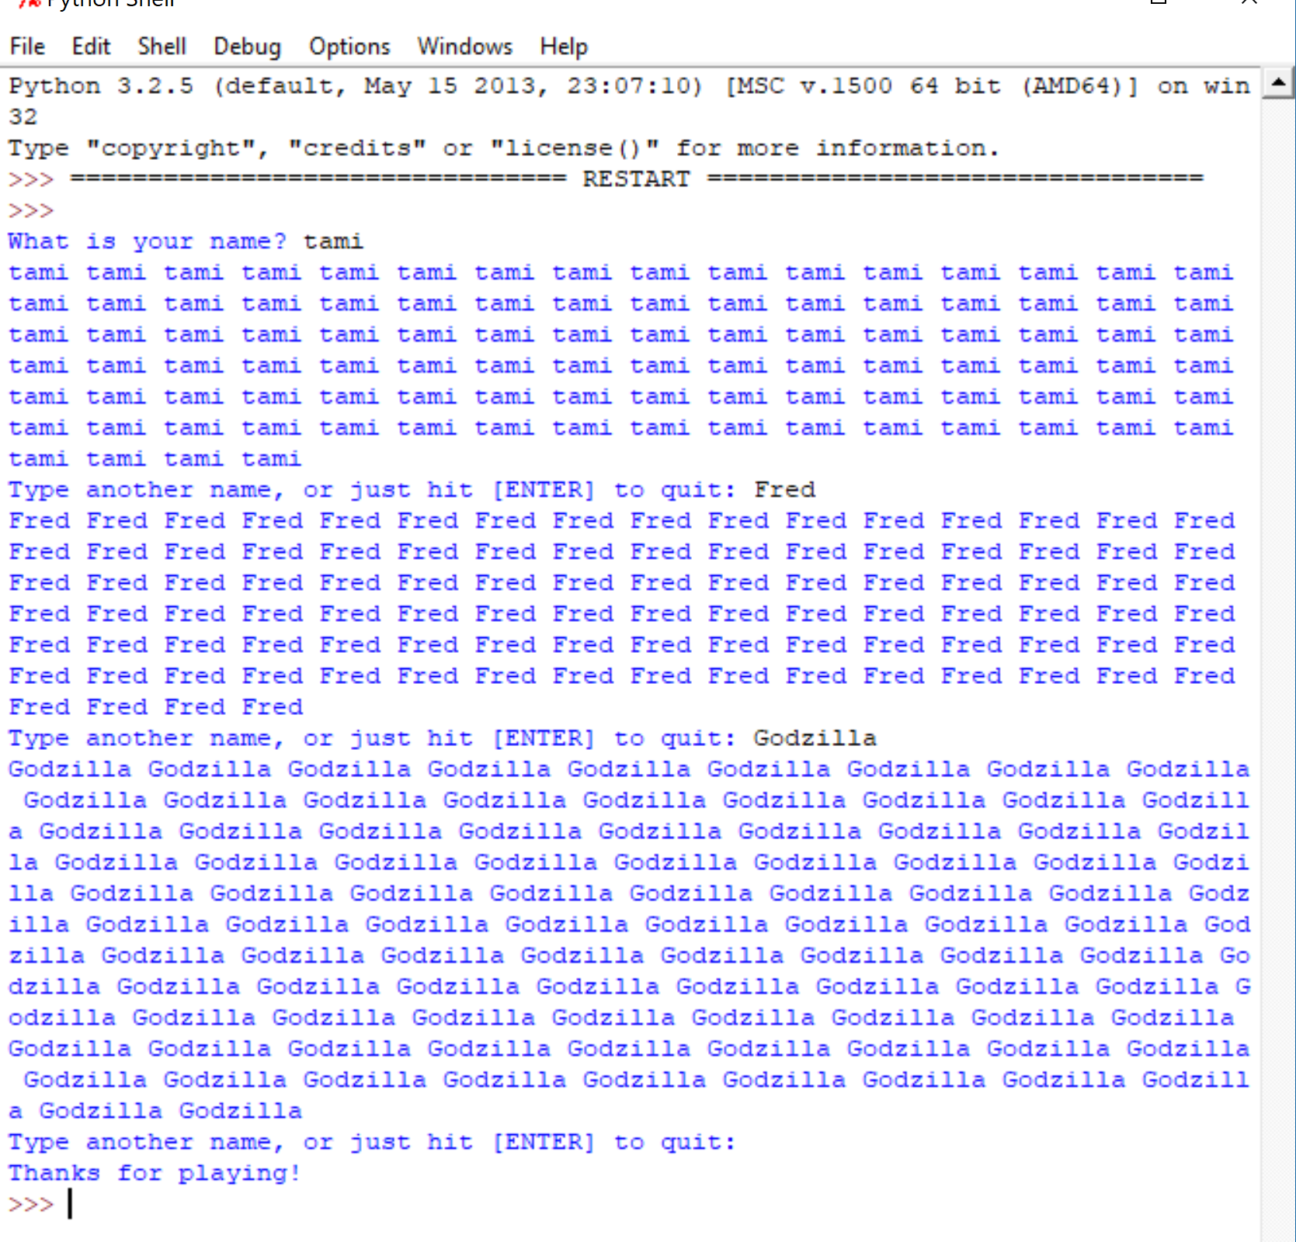

Slide 22
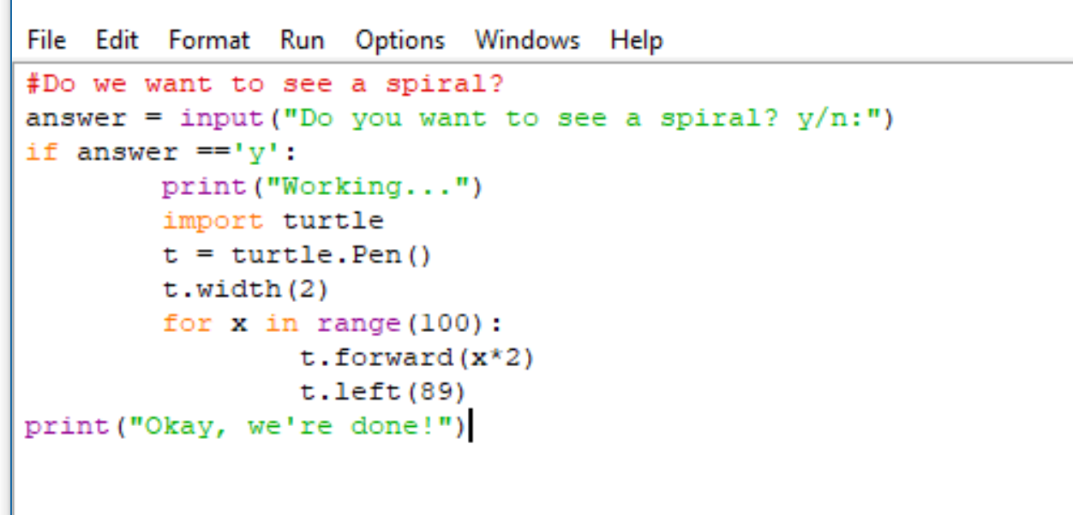
Conditional Expression (or Conditional Statement)
The computer checks a set of conditions, and acts upon the conditions (like when a thermostat sees the temperature in the room is too cold, so it turns on the heat)
“if. statements
If condition:
then indented statement(s)
In this program, it asks whether or not you want to make a spiral. If you say Y (yes), it does, if you say N (no), it doesn’t.
The double == means it is equal too, while NOT being an assignment operator (like name = in a variable)

Slide 23
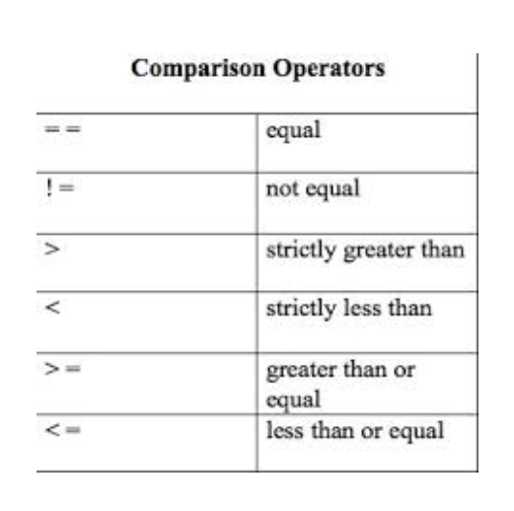
Conditional Expression and Boolean expressions
Expressions of true and false (There are many Boolean expressions. Here is a comparison operator example)
Are you old enough to drive?
*This program works, but it tests if you are too young AND old enough. You wouldn’t really do both. SO, look at the program on the next slide, and notice the if statement is followed by an ELSE statement. That way we can automatically answer in an appropriate way if the answer is true OR false.

Slide 24
Conditional expression if. Else. statement

Slide 25
Functions
Functions are pieces of code that we use a lot. We combine the code parts, and name them a short name to use.
Python (and other languages) have lots of functions built right in
Good examples are: input()……..random_spiral()…….turtle.forward()
Functions let us take advantage of our (and others’) programming work.
You can also make your own functions for commands you use a lot.

