Slide 1
A look at Small basic
The Text Window
2017

Slide 2
What is Small Basic?
Microsoft product
Programming language or environment
A Good, place to start when learning to code

Slide 3
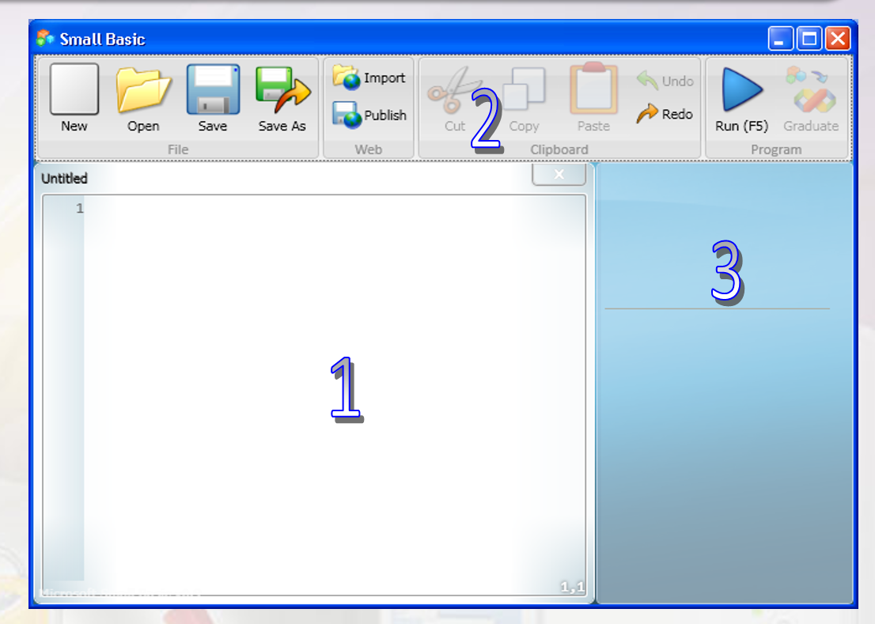
The Environment
Write programs in the Editor
2.Toolbar commands
3. Related information is displayed here
To Open Small Basic, look the “Programs” folder on the desktop. Double click on the SB shortcut file to open.

Slide 4
TextWindow.WriteLine(“Hello, Greenwood!”)
Write (input) your first Program
Put the line above in the editor
Click the run button in the toolbar
Check the resulting “OUTPUT”
Notice the “Intellisense” list (Helps)
Save in SB Folder

Slide 5
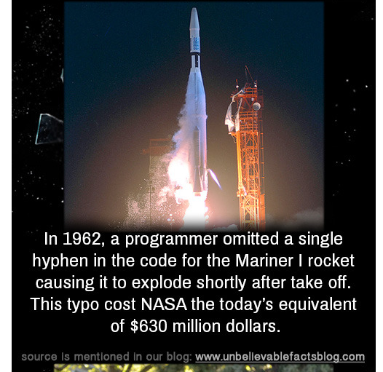
If you wrote the line correctly, when you run it, it will respond with “Hello, Greenwood”
If you wrote the line incorrectly, when you run it, it will tell you that you have an error.
You will have to
DEBUG it.

Slide 6
TextWindow.WriteLine(“Hello, Greenwood!”)
You created a “STATEMENT” by giving this instruction. Programs can be 1 statement or more!
Object:
item on which you can perform operations
Syntax: Set of rules by which the computer can read and understand your commands. (How you structure your programming “sentences”)
Operation: instructions for the object
String: characters together that stand for something. (In this case the greeting in quotes “”)

Slide 7
Objects have a specific set of Properties
TextWindow.BackgroundColor = “Gray”
TextWindow.ForegroundColor = “Red”
TextWindow.Title = “Fun With Small Basic Programming”
TextWindow.Top = 300
TextWindow.Left = 300
*300 is location on screen, not size

Slide 8
You can also interact with a user by having the computer READ what the user inputs Copy this program exactly
TextWindow.Write(“Enter your name:”) name = TextWindow.Read() TextWindow.WriteLine(“Hello ” + name + “.”)
WriteLine: puts the text on its own line.
Write: will just keep adding on the same line as long as space permits
Name = TextWindow.Read() is an example of a VARIABLE
Read(): computer reads back what the user inputs

Slide 9
You can even carry on a conversation…

Slide 10
Variables
Store different kinds of information, such as text or a number. A variable can contain different values at different points of time. (Microsoft)
Rules:
start with a letter: number_1
You can use letters, numbers, and underscores
Name so they describe whatever value you are needing
Don’t use If, for, or Then

Slide 11
Try a simple variable: Adding two numbers
number_1 = 30 number_2 = 55 number_sum = number_1 + number_2 TextWindow.WriteLine(number_sum)
You can also use variables with user’s input… think of it as a mini calculator.

Slide 12
Try a User Input Calculator!

Slide 13
Finding Area and perimeter
TextWindow.Title = "Area and Perimeter“ TextWindow.Write("How long is the rectangle?") Length = TextWindow.ReadNumber() TextWindow.Write("How wide is the rectangle?") Width = TextWindow.ReadNumber() Area = Length * Width Perimeter = 2 * Length + 2 * Width TextWindow.WriteLine("The area of the rectangle is " + Area + ".") TextWindow.WriteLine("The perimeter of the rectangle is " + Perimeter + ".")

Slide 14
You try1!
Title your Program “Lunch Order”
Write on its own line “Amount of ham sandwiches we would need for the whole class:”
Ask the user to specify “How many Ham Sandwiches for the Ladies?” by using the variable number_ladies
Ask the user to specify “How many ham sandwiches for the guys?” by using the variable number_guys
Create a variable called total that is the sum of number_ladies plus number_guys
Use a statement to display the amount of sandwiches we need to order totally. (Hint: TextWindow.WriteLine (We need to order “ +…
Save your program.

Slide 15
“You Try 1” Rubric
Item | Credit depends on | Points possible | Your points
Title (TextWindow.Title) slide 7 | Title is present and spelled correctly | 1
Text Statement (TextWindow.WriteLine) | Write on its own line “Amount of ham sandwiches we would need for the whole class:” | 2
Text for guys amounts and girls amounts (see slide 10) | User input questions are correctly coded and spelled correctly. | 3
Variables (ReadNumber) Total = number_guys +… (see slide 11) | Variables used to find guy’s and ladies’ amounts are correct. TOTAL variable is done correctly | 4
Final answer statement: (See slide 12, last line, using +Total+…) | Final total with statement “We need to order ____ ham sandwiches.” is present and correct. | 2 Total: ____/12 | Note: This program can be done in 8 lines of code.

