Slide 1
DIGITAL CITIZENSHIP | GRADE 8
Being Aware of What You Share

Slide 2
Essential Question
How can you protect your privacy when you're online?

Slide 3
Learning Objectives
l
Reflect on the concept of privacy, including what they feel comfortable sharing and with which people.
Analyze different ways that advertisers collect information about users to send them targeted ads.
Identify strategies for protecting their privacy, including opting out of specific features and analyzing the app or website's privacy policy.
2
3

Slide 4
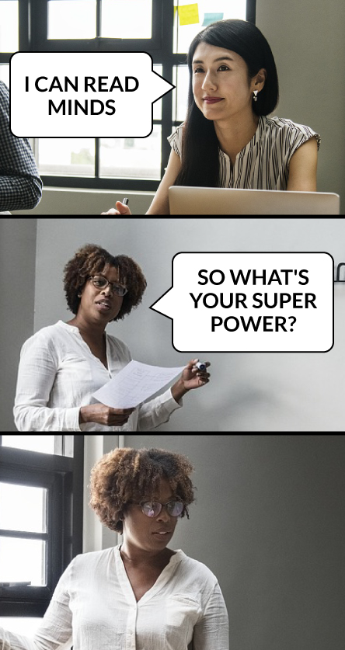
OBSERVE + ANALYZE IMAGE
Would it be fun to be able to read minds?
How would you feel if YOUR mind was being read?
Notes:
What do you think of this meme? Funny? Bottom image is someone showing someone’s reaction to learning that their mind is being read. Even though that sounds cool, it could be scary for everyone else that you could read their minds. Not sharing private thoughts is an example of PRIVACY.

Slide 5
Privacy
KEY VOCABULARY
Let’s read the AD DETECTIVE sheet. What do you think about it? Has this happened to you? How does it make you feel? (answer Q1)
Protection from being observed or tracked by others, including the government, the public, or selected individuals or groups
What if the ad was less direct? How about if you talked in social media about a friend moving to Europe, and then you got ads for trips to Europe?
Notes:
Can you think of things that people might want to keep private? Online it becomes more complicated…many times, what you put online is tracked or collected. Companies, especially track your information without you even being aware.

Slide 6
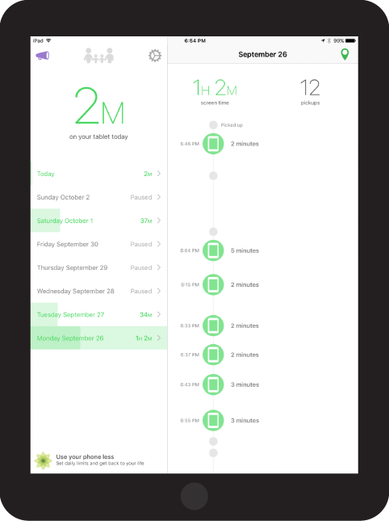
OBSERVE + ANALYZE IMAGE
Let’s look closer. Has anyone seen a screen like this before? What is it?
To use this site you have to agree to cookies.

Slide 7
Cookies
KEY VOCABULARY
Small text files placed on your device by the sites you visit that collect information about your device and your activity

Slide 8
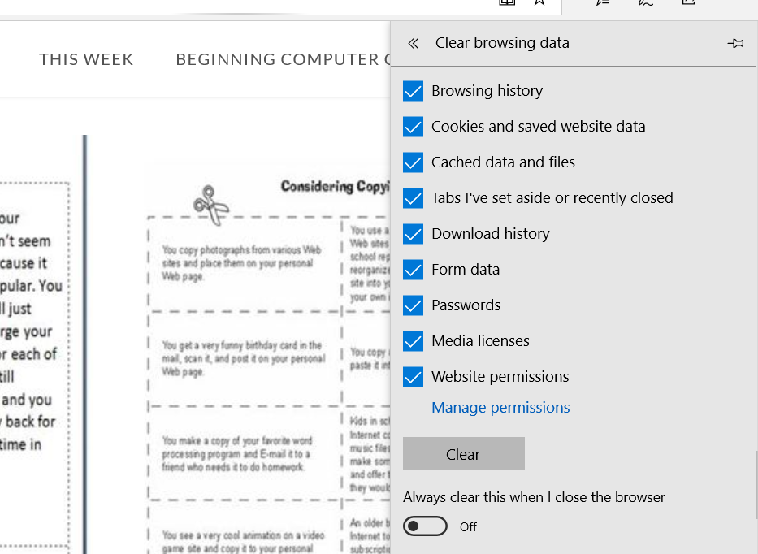
ACTIVITY: PROTECT YOUR PRIVACY
Tips for Protecting Your Privacy
Turn off cookies in your browser settings.

Slide 9
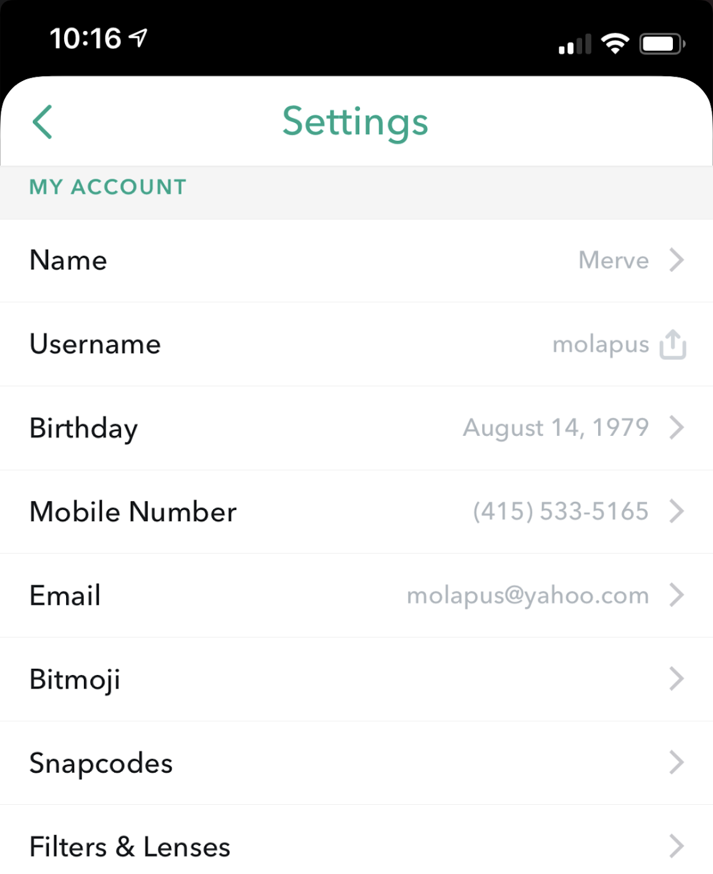
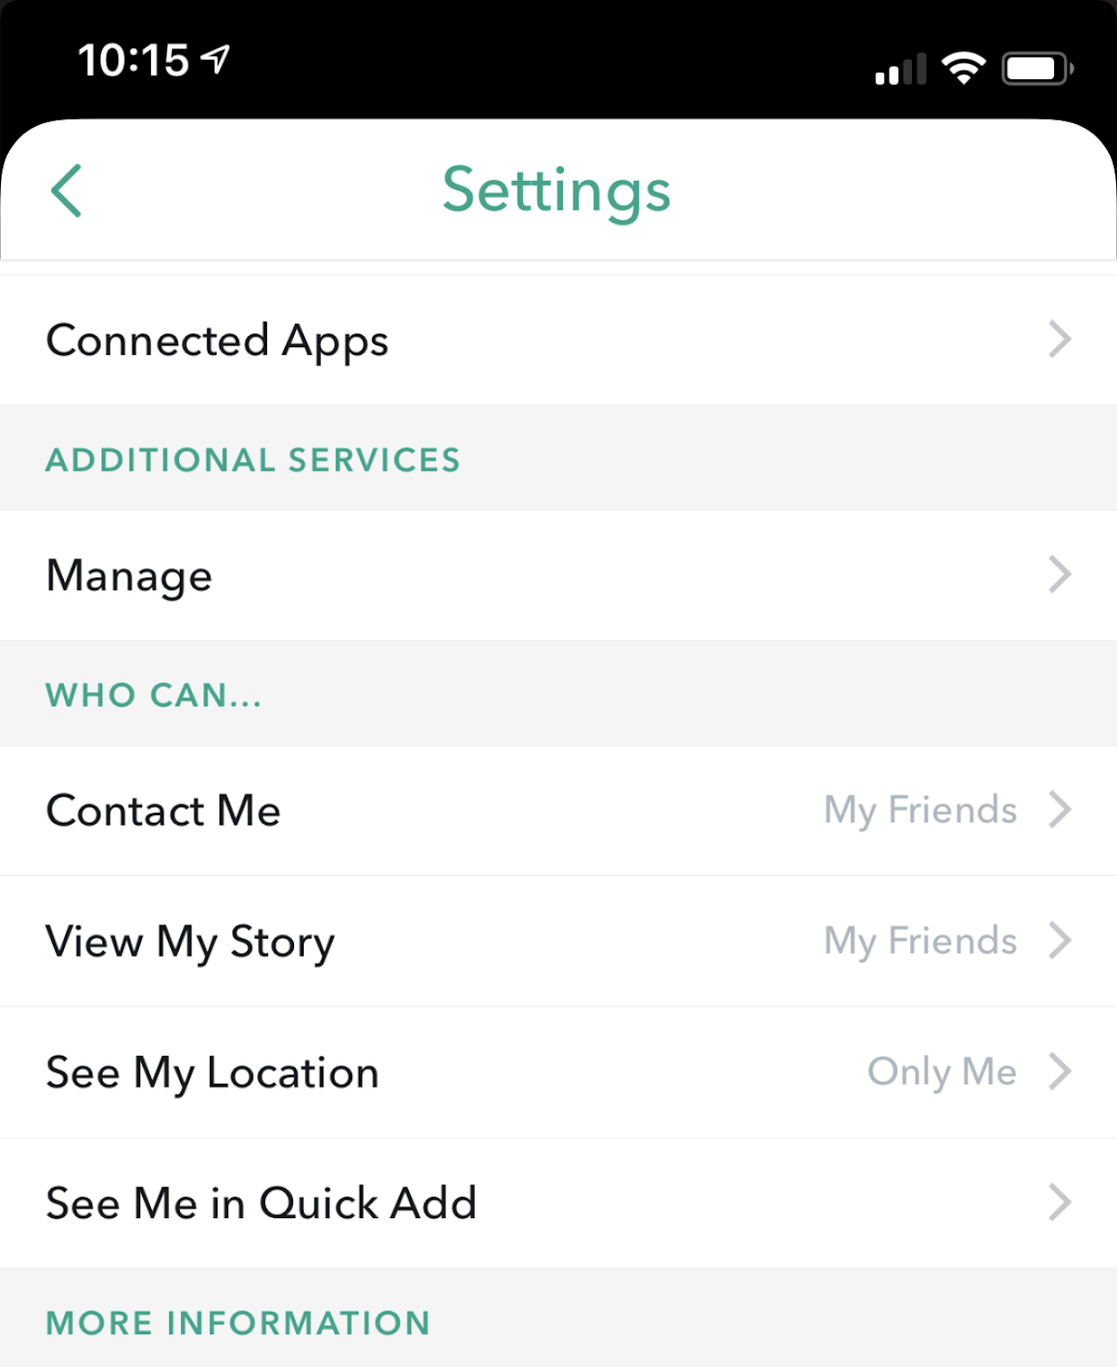
OBSERVE + ANALYZE IMAGE
What do these screens show? What could you use them for?
Notes:
Screenshots from settings within Snapchat’s app (Oct 2018).

Slide 10
Privacy settings
Opt out
KEY VOCABULARY
Choices a website or app might give you about what information is visible to other users and third parties
To choose to not participate in something

Slide 11
ACTIVITY: PROTECT YOUR PRIVACY
Tips for Protecting Your Privacy
Turn off cookies in your browser settings. Review the app's privacy settings and opt out of any sharing options you're not comfortable with.

Slide 12
Privacy policy
Terms of service
KEY VOCABULARY
A legal document that an app or website must provide and that describes what user information they collect and how they use it
A legal document that an app or website must provide and that describes the rules the company and users must obey when they use the app or website

Slide 13
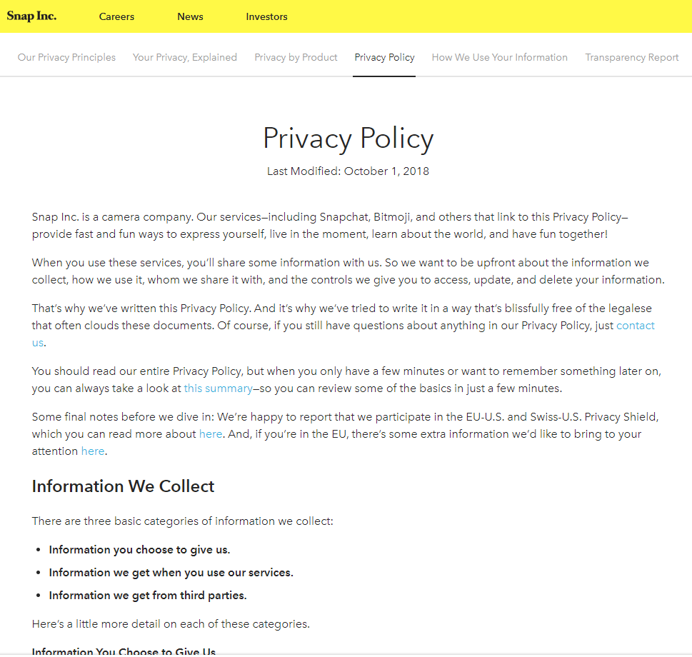
Accessed
What will be accessed?
Shared
What will be shared with other people or companies?
Known
What could be known about me if I use this?
ASK
Extra time: Take a moment to look at the Fortnite Privacy Policy and terms. You might be surprised what they can do with your information.
Notes:
Screenshot from Snapchat’s privacy policy: https://www.snap.com/en-US/privacy/privacy-policy/

Slide 14
ACTIVITY: PROTECT YOUR PRIVACY
Tips for Protecting Your Privacy
Turn off cookies in your browser settings. Review the app's privacy settings and opt out of any sharing options you're not comfortable with. Review the privacy policy and terms of service and use ASK to analyze how using the app will affect your privacy.
Let’s go back to Keet’s example. What do you think he could’ve done to protect his privacy more? What information are you OK with sharing?

Slide 15
Protecting yourself from Identity Theft Scams and Schemes

Slide 16
Identity Theft
Understand what it is
Know why its important to guard against it
Learn to recognize strategies scam artists use to get private information
Learn to guard against phishing and identity theft
Do you know someone who has been scammed? What happened? What was the purpose? What tricks did they use? How can people be scammed on the Internet? Besides ASKING for money directly, how else do identity thieves use your information?

Slide 17
Useful Personal Information
Can you guess what information makes you vulnerable?
Full name
Date of Birth and where you were born
Current and previous addresses and phone numbers
Drivers license or passport numbers
Account numbers for companies you use (paypal, amazon, visa credit etc.)
Passwords
Social Security Number

Slide 18
Let’s catch a phish…
How can you spot a scam?
Try the ones you have on your worksheet.

Slide 19
“Protect Yourself” Recap:
Be suspicious of any online communication that asks for personal information
If from a “friend”, ask yourself if it is in character for that friend.
Don’t reply to unknown addressees
Don’t click on any links, even to close
Report it as spam or junk
Go to ftc.gov to report your identity stolen
Forward spam to spam@uce.gov if it looks suspect.

