Slide 1
Entrepreneurship and the
Marketing Business

Slide 2
Welcome!
“Best Buys”
Board of Directors Discussion
We need to choose several new products to display and sell in our store for the spring season.

Slide 3
Business/Company Vocab
Standard 18.1
Entrepreneurship: process of creating and running a business, assuming the risk for (hopefully) profit

Slide 4

Business Revenue
Standard 18.7
Total coming into the business
(Gross profit)
Notes:
The amount of money that a company actually receives during a specific period, including discounts and deductions for returned merchandise. It is the "top line" or "gross income" figure from which costs are subtracted to determine net income. (www.investopedia.com/terms/r/revenue.asp)

Slide 5

Business Expense
Standard 18.7
Costs to run the business
(deductions)
Notes:
Any expenses (items that cost YOU) incurred in the ordinary course of business. Business expenses are deductible and are always netted against business income. www.investopedia.com/terms

Slide 6

Business Net Profit
Standard 18.7
What the company makes
Like the net income
Notes:
A financial benefit that is realized when the amount of revenue gained from a business activity exceeds the expenses, costs and taxes needed to sustain the activity. Any profit that is gained goes to the business's owners, who may or may not decide to spend it on the business. (like “net income” in business) www.investopedia.com/terms

Slide 7
Answer these questions
Think of a business or store or brand you like or buy things from (Write it down)
What product or service do they provide?
How does the company advertise? How did you find out about them?

Slide 8
Three Types of Business ownership
Standard 18.5
Sole Proprietorships (small business).
one person owning and operating a business (Advantages: ease of start/ending business, own boss, less regulation / Disadvantages: unlimited liability, limited financial resources)
Kinkos, Annie’s homegrown all began as SP. Most landscape services, bookkeepers, caterers, writers, tutors, small shops, Kiosks, financial planners own their own businesses

Slide 9
Three Types of Business ownership
Standard 18.5
Partnerships
legal business with two or more parties (Advantages: financial resources, shared risks, no special taxes / Disadvantages: unlimited liability, profits shared, disagreements)
Google, Apple, Microsoft, Hewlett-Packard, Most lawyer/MD firms, Ben & Jerry’s, Proctor and Gamble, many construction/management companies are (or began as) partnerships.

Slide 10
Three Types of Business ownership
Standard 18.5
Corporations (usually LARGE)
legal entity with authority to act/have liability separate from owners (Advantages: limited liability, more money to invest, talented employees / Disadvantages: double taxation, expensive to incorporate, hard to terminate)
Ford, Coca-Cola, IBM, Microsoft (now), Exxon Mobile, ATT, NewsCorp, TLC,

Slide 11
Is the business you wrote down a sole proprietor (small business), partnership (Small business) or Corporations?
How many corporations started as one of the first 2 types, do you think?
Do you support small business?

Slide 12

All of these business depend on Marketing
To set up their business
To inform people about their product
To sell their product
To make a profit

Slide 13
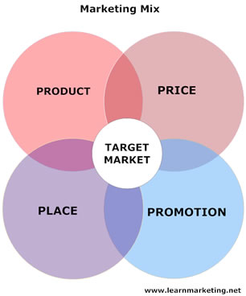
Successful Marketing considerations Include…
Product (branding)
Price
Place of Purchase
Promotional ideas for advertising
Some Companies have a branding so strong(logos, brand names) that they are familiar even without the company name included.

Slide 14
Brands and Business Logos

Slide 15


Slide 16
Apple Computers

Slide 17


Slide 18
Pepsi-Cola

Slide 19


Slide 20
Major League Baseball

Slide 21


Slide 22
Honda

Slide 23


Slide 24
AT&T

Slide 25


Slide 26
Windows Operating System

Slide 27


Slide 28
Fruit of the Loom

Slide 29


Slide 30
Volkswagen

Slide 31


Slide 32
American Red Cross

Slide 33


Slide 34
Shell

Slide 35


Slide 36
Hello Kitty

Slide 37


Slide 38
United States Postal Service

Slide 39

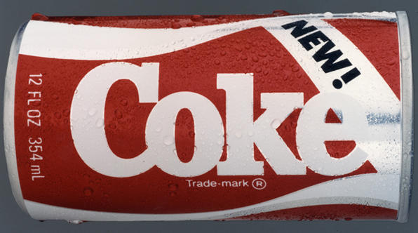
Logo Updates
Old one
Newer one

Slide 40
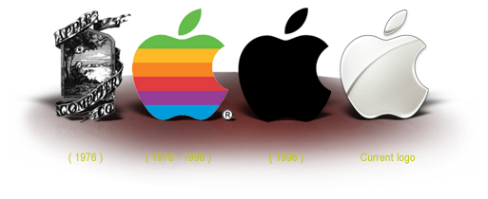
What can you say about the changes in the Apple Logo through the years?

Slide 41


How about this one?

Slide 42


Mattel Toys
Some change
A lot

Slide 43

Some, not so much
Old one
New one

Slide 44
Every year, people are hired by companies to sell (or market) their projects.

Slide 45
Congratulations!
You work for a technology company. A company that wants a PROFIT.
Best Buys is considering one of your products in their store. Your company wants you to MARKET a technology product for them. (Sales pitch it)
Using the 4 P’s of Marketing, prepare a presentation that will “wow” the corporate execs! See your directions for specifics.
Here are the 4 P’s of Marketing again:
(Standard 17.3)

Slide 46
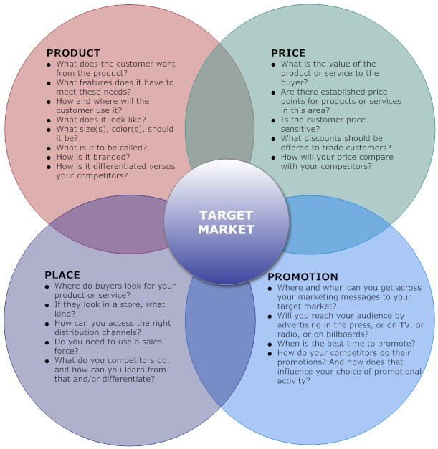
4
P’s of Marketing

Slide 47
The Sales Pitch
In a Sales Pitch, you need to be very knowledgeable about your product, and how to sell it.
You will be presenting….
Here’s how to be a good salesman….

Slide 48
What is a good presentation?
Selling a product is all about communication.
It is showing you are KNOWLEDGEABLE
And ENTHUSIASTIC,
And LIKABLE…
The Do’s and Don’t of PowerPoint
Standard 16.6 and
Core Standard 17 (all)

Slide 49
DO NOT Have Too Much Text
Too much text on the screen is a bad thing. It tells the audience that you don’t think they can read on their own and shows that you might not know as much about your topic as you should. You should be able to provide some extra information that isn’t on the slide. By reading this to you right now, I am probably boring you and you are losing interest in what I am saying.

Slide 50

DO Provide Short Guiding Points
Provides the audience with main ideas
Gives the presenter reminders
Makes the audience listen
Use bullet points as guides
Elaborate on each point
Makes room for pictures
Notes:
Write notes for what you will say in this notes section

Slide 51

DO NOT Read From the Screen
Have notes! Write them in “notes” area
  Note cards are okay!
Hard to hear
Boring
Unsure of yourself

Slide 52

DO Face Your Audience
Make eye contact with everyone
Be confident
You know…your audience doesn’t!

Slide 53

DO NOT Use Crazy Color Combos
Hard on the eyes
Difficult to focus on content
Unprofessional

Slide 54
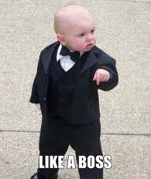
DO Look Professional
Be creative but neat
Think like a boss
Don’t distract from the content!
What is important on your slide? Whatever it is, it should stand out!

Slide 55
Your Google Apps Presentation Must Include…
Professional background
Graphics
Notes/comments
Simple Transition
1 Hyperlink going to the company that sells it.
Your new interpretation of their logo, made in PE.

Slide 56
Do’s and Don’t Summary
Do:
    Provide short bullet points
    Face your audience
    Create professional-looking slides
Do Not:
    Put too much text on slides
    Read from the screen
    Use crazy color combos

Slide 57
When speaking…
Do:
    Move. Use hand gestures to explain.
    Face your audience, and speak slowly and clear, but with energy.
    Practice beforehand
    Be professional
Do Not:
    Freeze up.
    Read from the screen
    Look down awkwardly
    Speak too softly or rapidly
    Take yourself TOO seriously. Just the facts!

Slide 58
Start your Marketing Project for a CORPORATION
Sit with your partner (today only)
Get out a scratch sheet and the Internet
Read 1-2 in your direction sheet
Check out 3 products you'd like to promote(specific brands and models)
Write them down
Bring me the list, and pitch me the one you want.
One product per class (When it’s OK’ed…..)
Set up a “partner google doc presentation”…look up info about the product..Read what you need for slides
Read your direction sheet. THE WHOLE THING!
Hint: It’s the 4 P’s of Marketing (DIVIDE YOUR WORK)
PRODUCT PRICE PLACE PROMOTION
Include not only what exists, but how YOU would promote the product as a Marketing agent.

Slide 59
Marketing Project Work Day
Open Google Slides presentation
Read your direction sheet. THE WHOLE THING! It will give you ideas for what to include. You should research DEEP!
DIVIDE YOUR WORK, AND PUT YOUR INITIALS ON THE SLIDES YOU DID, please.
Be specific when giving persuasive evidence!
Use “Chat” for communication. (MLB.16.3-16.4)
KEEP IT EDUCATIONAL
4 P’s are PRODUCT +PRICE +PLACE +PROMOTION
Double check your work against the rubric (no paragraphing)
Use 3X5 cards or printed notes. Phrases, not paragraphs on slides!!
Don’t forget “logo redo”. Include it where it fits best.
Conclusion: We’d like to thanks our company…and the Best Buys Board of Directors for this opportunity.

Slide 60

Thanks to…
Microsoft Corporation
Best Buys
Board of Directors
Notes:
I would like to thank my employers from _______ for allowing me to represent their product, and I’d like to thank you, the Best Buys Board of Directors for this opportunity to speak with you. I hope you will consider our product for your store.

Slide 61
PRODUCT PRICE PLACE PROMOTION
Prepare your presentation
Sit with your partner. Work Quietly.
Set up who will say what. Divide evenly.
Use 3X5 cards for reference or print notes. (6/page)
Look at the rubric and double check that you have all bases covered.
Practice your speech in “PRESENT” Check links/video
Do SPELL CHEK (HA)
Assume you are all presenting Thursday.
If you are off task, I will assume your presentation is PERFECT, and I will expect that when grading the actual presentation.
If you don’t need to the whole period to prepare, go to the bottom of my “This Week” page, and do the coding link.

