Slide 1
Researching
Using RACE
(It’s different than doing an informational essay)

Slide 2
In Research…
You read information, make conclusions, and organize in your own words. You still cite who said it.
You behave as if no one has looked at this from your particular angle, so you need to interpret the material in a new way. (In this case, you are advertising a National Park you’d like someone to visit)
You NEVER copy anything someone says unless you mean to quote them. (and you should have these too)
It’s one thing to answer a question. It’s another to persuade someone with proof.

Slide 3
The RACE Method
R: Restate the question
A: Answer that question
C: Cite (including who said it) evidence (proof) from a specific source to support your answer. (at least 2)
E: Further explanation and go into detail about each evidence (proof)

Slide 4
Don’t Be This Person…

Slide 5
The “Man of Few Words”
Making a statement without giving us a reason or proof.

Slide 6
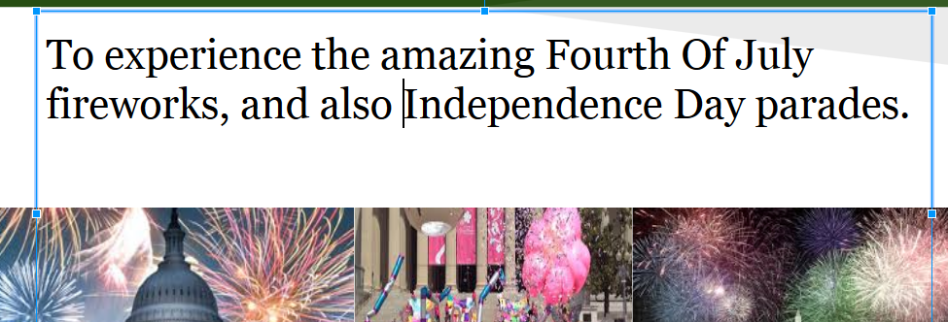
The BSer…
This person does very little actual information. If you read it without the title, their statements could be about just anywhere.
This is a really cool place to go. You can hike and see all of the awesome sites there.

Slide 7
The Plagiarizer
The World trade center is located in downtown New York.
It combines modern safe and sustainable commercial space, convenient transportation, and a destination cultural center.

Slide 8
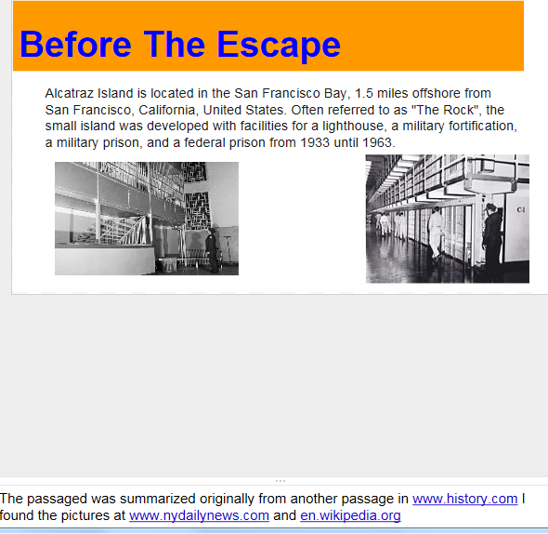
The Wikipedier…
What part of “YOU CAN’T USE A WIKI FOR RESEARCH DID YOU NOT UNDERSTAND????????????
On the list of “Google acquisitions”, you will find “wikipedia”. Think this might be why it is the #1 result that returns from a search? Its not because it’s the most relevant or useable.

Slide 9
The Googler:
The person who thinks all pictures are found at google.com and all music at iTunes, and that one could actually find the picture/song with that information. Note: There are millions of pictures/songs at those sites. Its like answer the question, “where is my house?” with “Its in the Northern Hemisphere”.

Slide 10
The Squirrel Sighter…
This person ignores the main point of the information, and is distracted by the first thing they read. They concentrate on telling us unimportant, irrelevant information.
*Things like the weather there today or what tickets cost, when the question was “Why would this be a great National Park to visit”.
This is also the guy, when asked “What time is it?” will hear, “What KIND is it?”, and will tell you “Fossil” or “Timex”

Slide 11
The Non-Citer
Has great information, but does not tell where they found the information. In HS, this would be an automatic F.

Slide 12
Example: RACE
1. Restate the question
2. Answer the question
3. Cite evidence (2 pieces) The resource says…
4. Explain fully about your evidence (2 pieces)
3. Cite evidence (the 2nd piece) Another resources says
4. Explain fully (the 2nd piece)

Slide 13
Example: RACE
Original Question: Why would the WWII monument be a good place to see on your next visit to Washington DC?
The WWII monument in Washington DC would be a great place to visit because it commemorates one of the largest and costliest wars that the USA has ever been in.
CITE EXAMPLES of how its commemorated:
Worldbook says “THERE IS A PILLAR FOR EACH OF THE 50 STATES.” They have a wreath on the front and the back, and the name of the state on them. Many people go there to take a picture of in front of their state. Together, the pillars form a large circle around a water basin and fountain.
Also, in the National Park Service website, it states “there are 4000 stars that” commemorate the 400,000 dead from the war. That’s 1 for every 100 soldiers, nurses, and other service people that were killed. It is compelling to see that many stars, and know each is just a fraction of the lives lost.
Finally, Mr. Rhinehart says “there are CARVINGS OF MEMORABILIA OF THAT TIME” LIKE THE KILROY CARTOON THAT MANY SOLDIERS LEFT. There are also carvings of the Pacific (like where we dropped the atom bomb, and European conflicts, like stopping Hitler from taking over France or England.

